Slide 1
Organic manure making MOOC PROJECT II
Noel Mathew Oommen
D2 English
Catholicate College , Pathanamthitta

Slide 2
introduction
Organic manures are natural products used by farmers to enhanced sustainable crop production. There are a number of organic manures like farm yard manure, green manures, compost prepared from crop residues and other farm wastes, and biological wastes - animal bones, slaughter house refuse.
Organic manures increase the organic matter in the soil. Organic matter in turn releases the plant food in available from for the use of crops. However, organic manures should not be seen only as carriers of plant food. These manures also enable a soil to hold more water and also help to improve the drainage in clay soils. They provide organic acids that help to dissolve soil nutrients and make them available for the plants.
The nutrient content of organic manures is highly variable from place to place, lot to lot, and method of preparation. The composition of fertilizers is almost constant.

Slide 3
Benefits of composting:
Increases microbial activity.
Enhances plant disease suppression.
Increases soil fertility.
Improves soil structure in clayey soil.
Improves water retention in sandy soil.
Reduces bioavailability of heavy metals.
Increases cation exchange capacity.

Slide 4
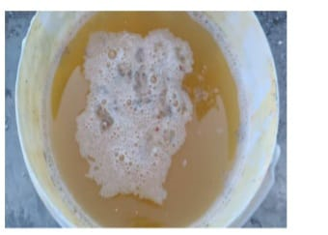
Methods and materials
MATERIALS REQUIRED:
Kitchen wastes including vegetable waste , fish waste , food waste , etc. Waste should be devoid of plastics , oily materials , bottles , and liquefied food wastes.
Bio bins to hold the kitchen waste. Bio bins can be earthen made similar to garden pots or PVC pipes of 200 mm diameter. Micro pores on the bin wall ensure aeration that facilitates microbial activity. The holes in the bottom of these pots are then closed using cement mortar.
Composting inoculums are consortia of microflora that can easily decompose vegetable and food wastes. They include bacterial and fungal strains. Microbial inoculation with specific bacteria or enzyme – producing microbes can enhance the composting process by ensuring the right microbes are in the right temperature , oxygen and moisture regimes in the piles at the right time.
Inoculum

Slide 5
PREPARTION:
Take 100g of jaggery , 1.5g of water decomposer and mix it well in a plastic drum containing 10 liters of water. Use a wooden stick for stirring. Now cover the drum properly and stir it well once or twice for the next 5-6 days. After 6 days , the solution turns creamy in texture , which means it is ready for use.
COMPOSTING PROCESS:
Large garden pots are the simplest and cheapes.t containers for kitchen waste composting. The base holes of the pot are closed , if there are any. At the bottom of the pot , a layer of soil and dry leaves or papers are spread at 1” thickness. Above this layer, spread the kitchen waste of the day. Over this layer , add the composting inoculum which we prepared. The bin should be covered with a tile or a wooden plank . This process of filling and addition of inoculum should be continued daily. The moisture within the bin has to be regulated by spreading coir pith or dry leaves. A little bit of water can also be added. After 7 days open the pot and stir its contents for a while. It can accelerate the decomposition process. After 30 to 35 days of the last filling , the compost is taken out. The brown colored compost in powder form is quality manure that can be used for nourishing crops including vegetables and fruits. A second pot maybe prepared and filled as above subsequently.

Slide 6
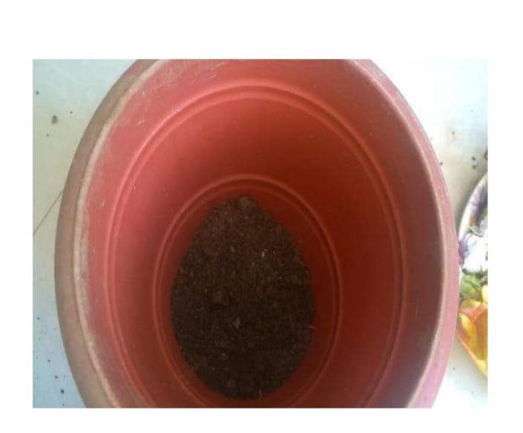
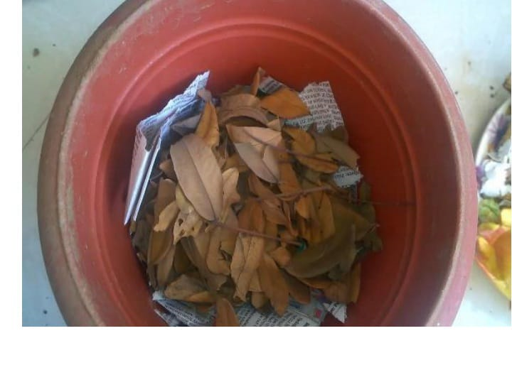
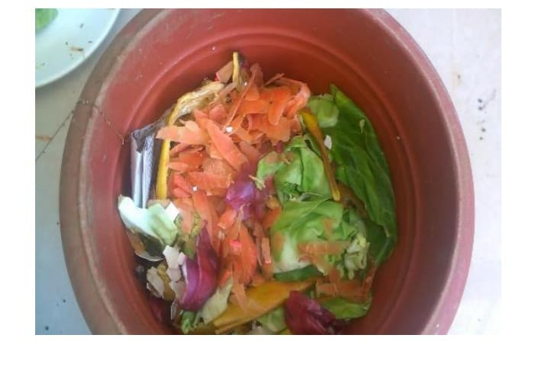
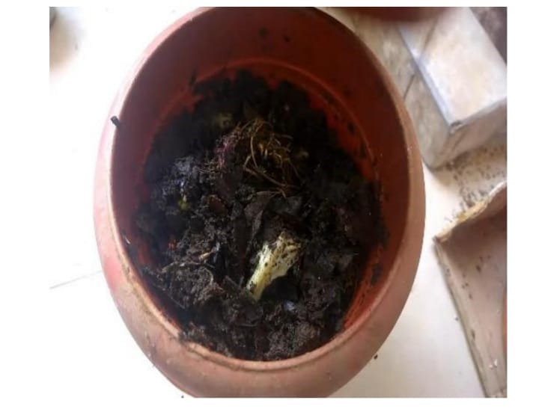
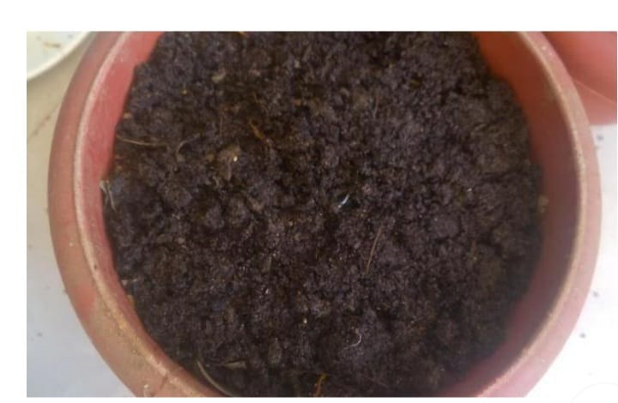
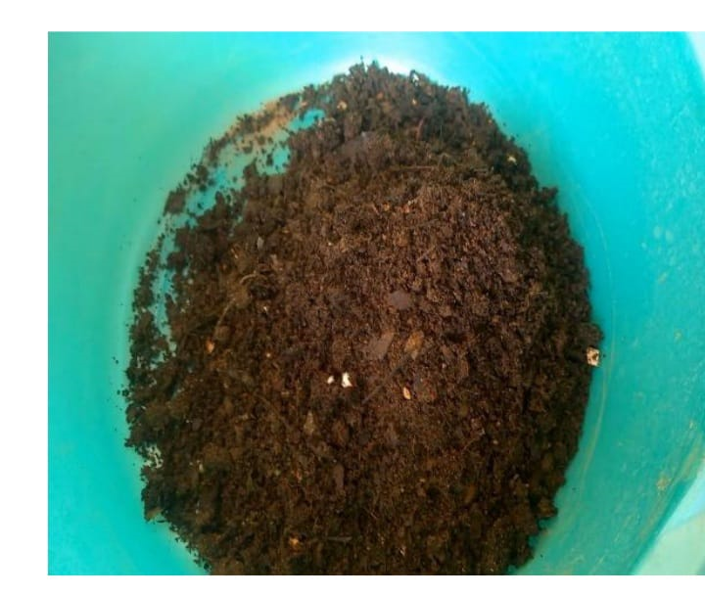
Pictures
Stage 1 Stage 2 Stage 3
Stage 4 Stage 5 Stage 6

Slide 7
Conclusion
Composting , as a treatment of organic waste , had been proven to significantly reduce the volume of wastes in the country. In addition , composting can also provide nutrients that are suitable for agriculture and can be used as fertilizer to replace chemical fertilizer. Furthermore , compost can also be used as soil amendments as well as being eco-friendly , hygienic , economical and toxic free. Proper management of solid wastes reduces or eliminates adverse impacts on the environment , human health and supports economical development for the better quality of life. The productivity of agricultural land and soil quality neds improvement. Therefore , the aim of this study is to convert kitchen waste into a useful product for the better growth and quality of crops and thus this low cost technology has a very high economic , environmental and social relevance.

